Slide 1
Superstore Sales Dataset analysis

Slide 2
General view

Slide 3
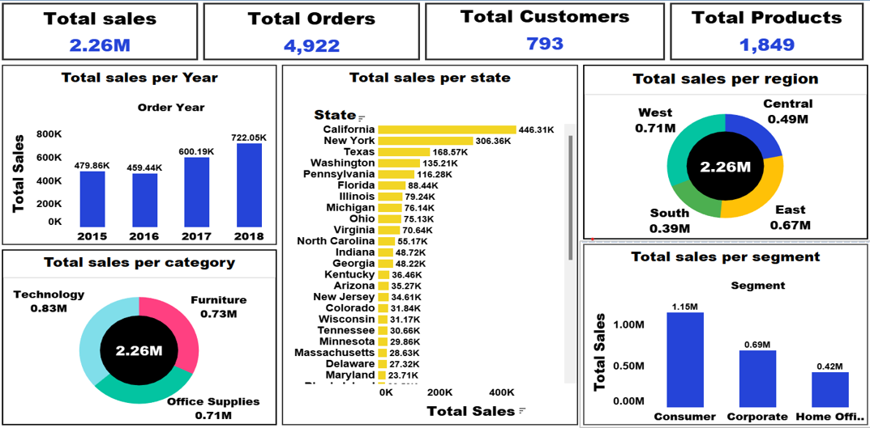
General view

Slide 4
Customers and products analysis

Slide 5
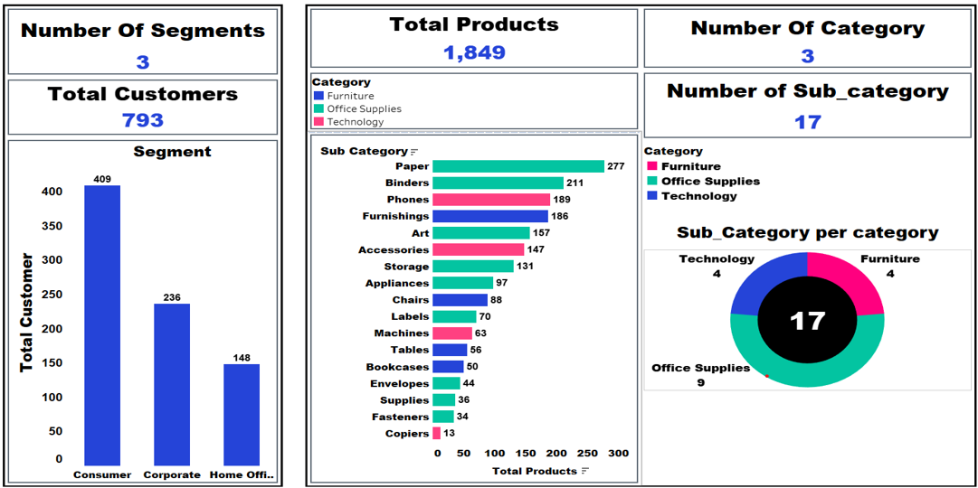
Customers and products analysis

Slide 6
Orders analysis

Slide 7
Orders analysis
01
03
02
04
Per Location
Per Customer
Region
State
City
Segment
Customer name
Per Product
Per Ship_mode
Category
Sub_category
Product name

Slide 8
01
Orders analysis Per Location

Slide 9
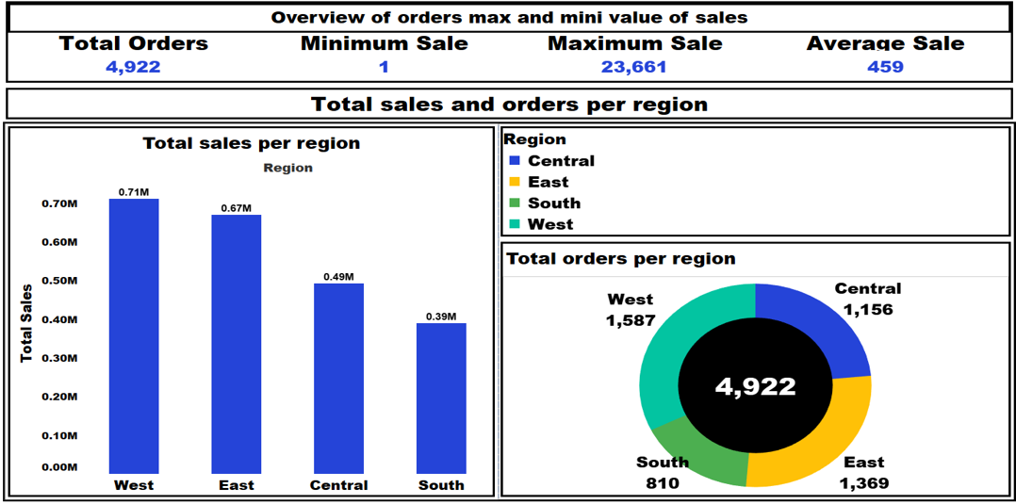
Orders analysis Per region

Slide 10
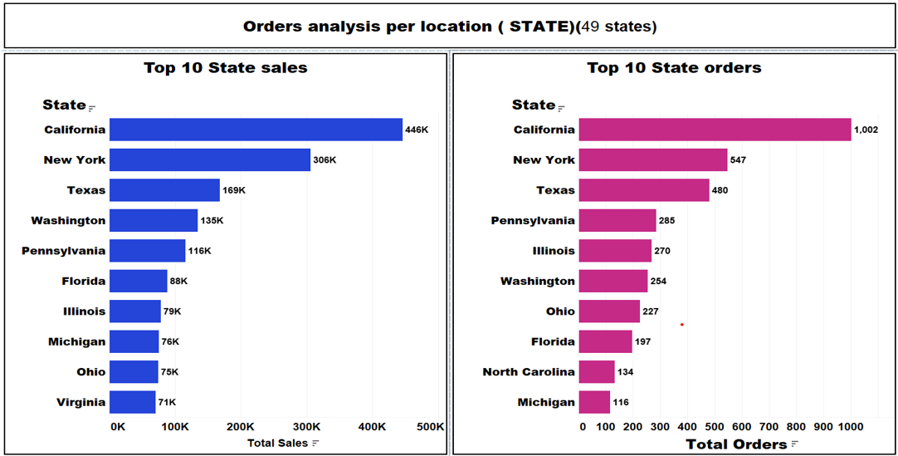
Orders analysis Per State

Slide 11
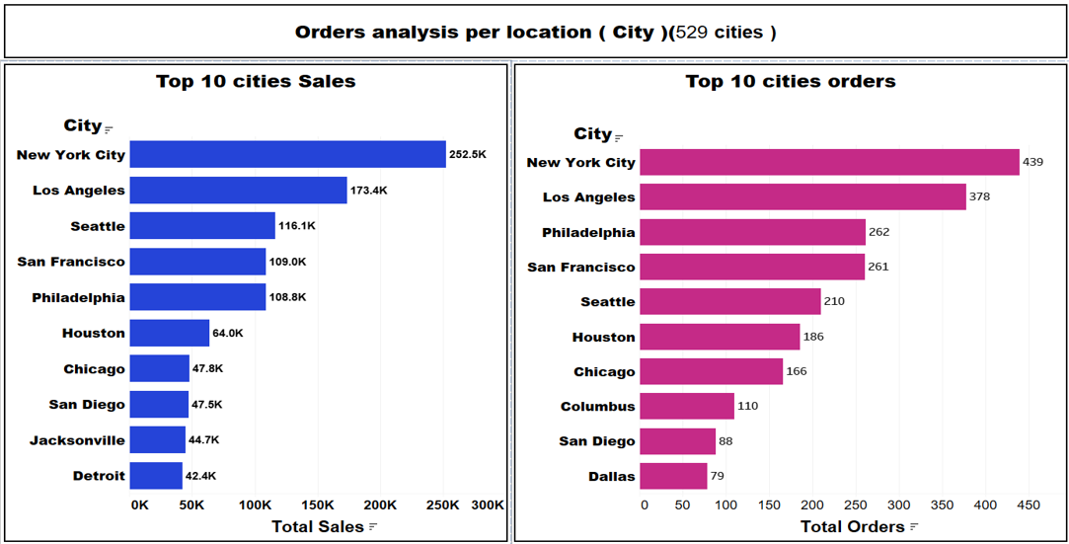
Orders analysis Per City

Slide 12
02
Orders analysis Per Product

Slide 13
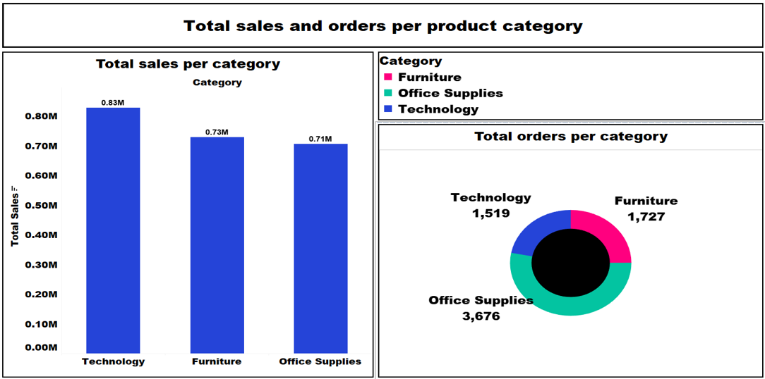
Orders analysis Per Category

Slide 14
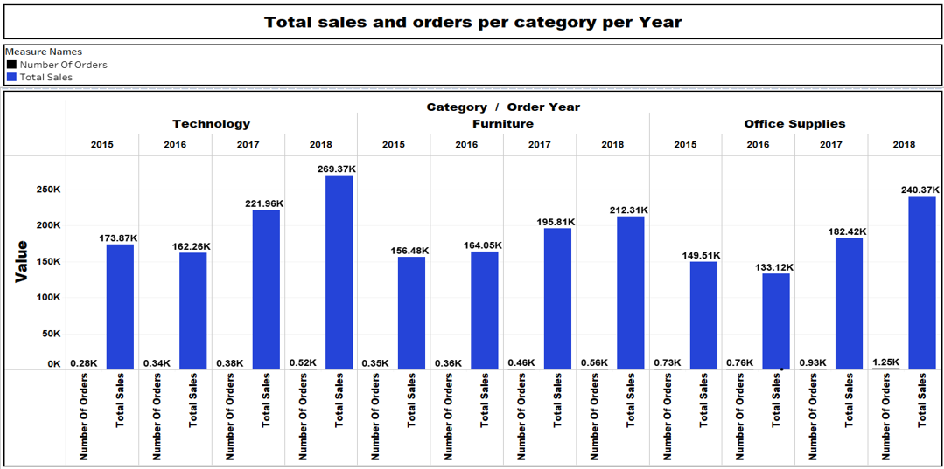
Orders analysis Per Category and year

Slide 15
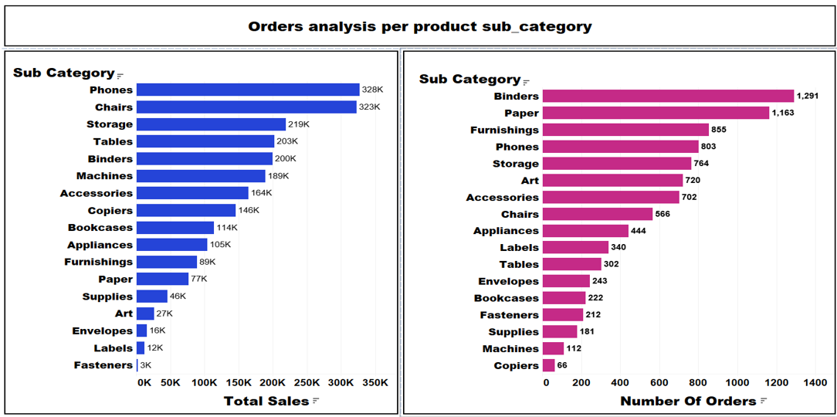
Orders analysis Per Sub_category

Slide 16
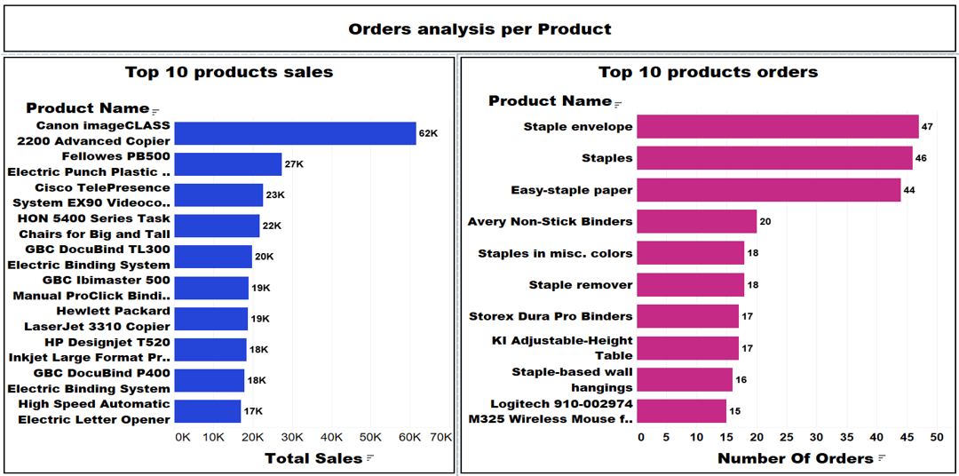
Orders analysis Per Product name

Slide 17
03
Orders analysis Per Customer

Slide 18
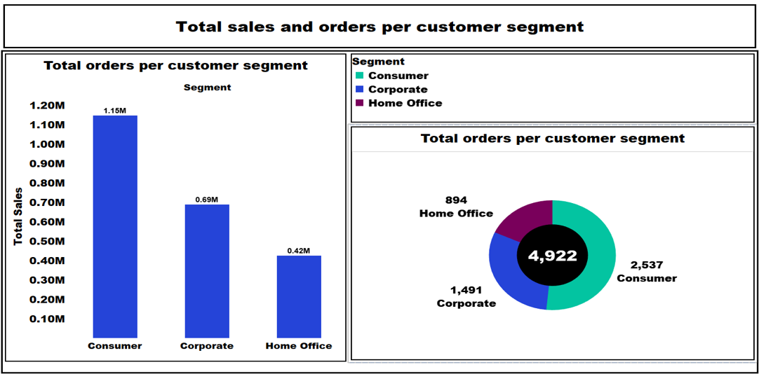
Orders analysis Per Segment

Slide 19
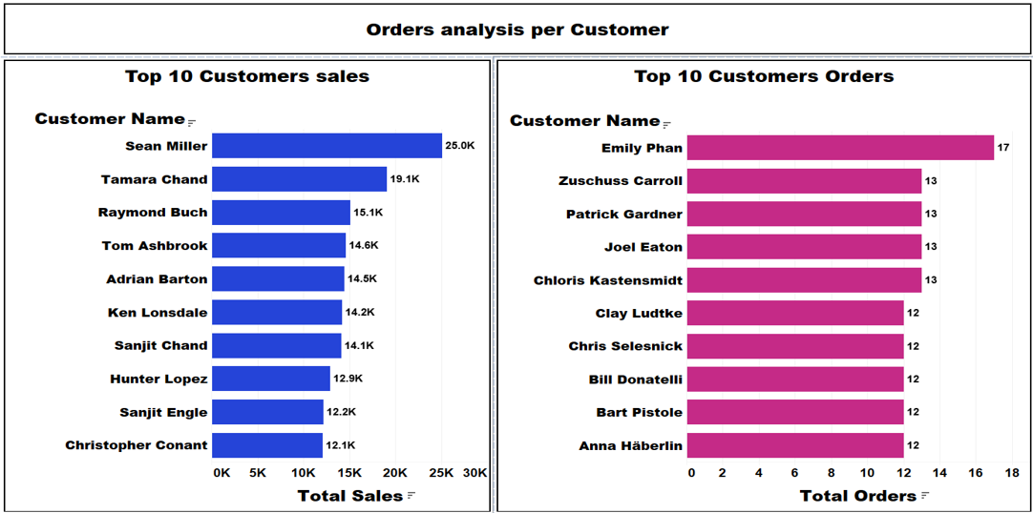
Orders analysis Per Customer name

Slide 20
04
Orders analysis Per Ship_mode

Slide 21
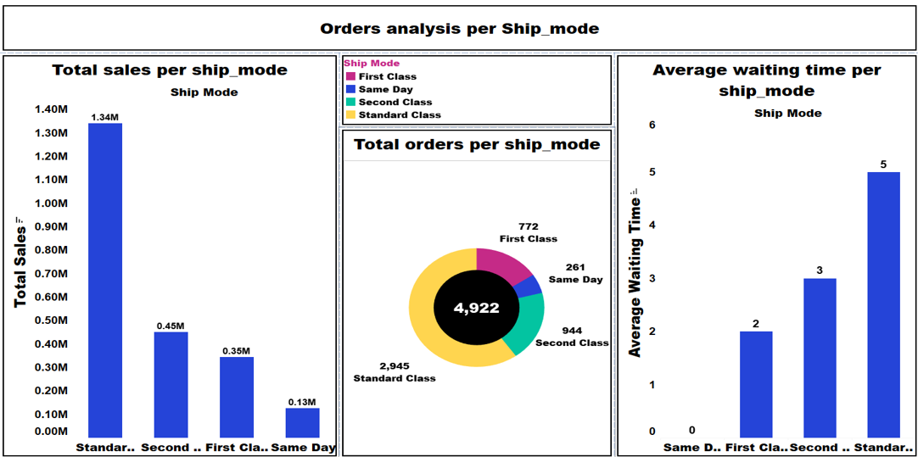
Orders analysis Per Ship_mode

Slide 22
How does *Ship Mode* impact sales for different product categories and regions?

Slide 23
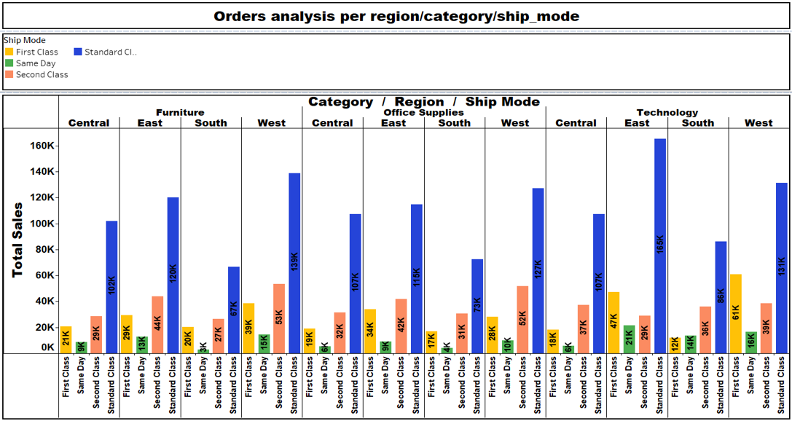

Slide 24
Customers distribution of each ship_mode

Slide 25
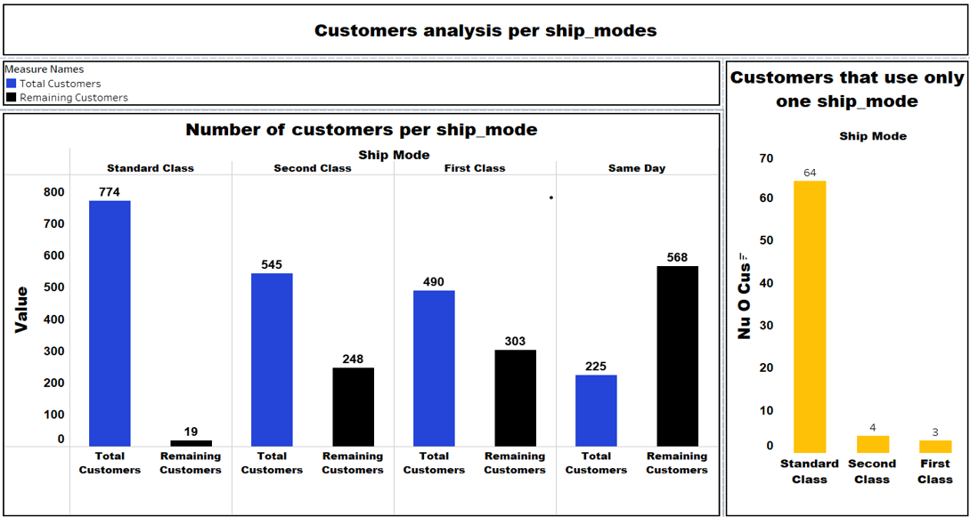

Slide 26
Are there any specific *Product Categories* showing consistent growth or decline in sales?

Slide 27
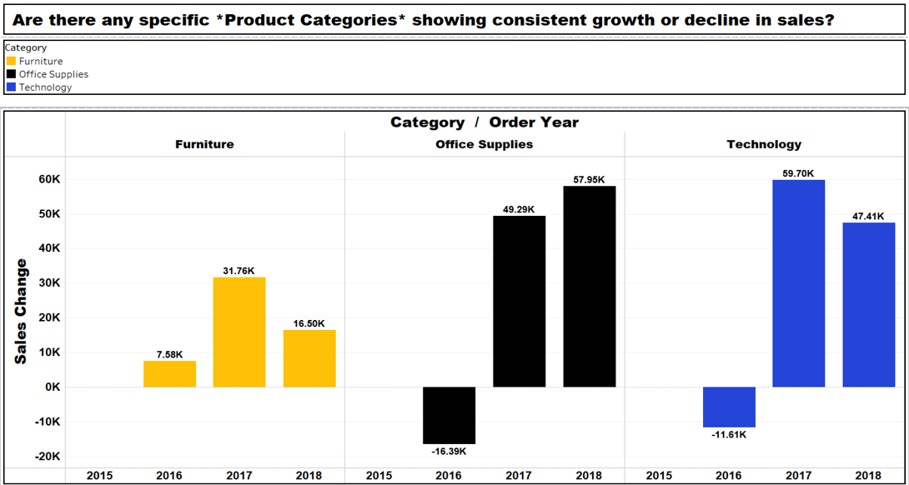

Slide 28
How does the number of items per order impact total sales?

Slide 29
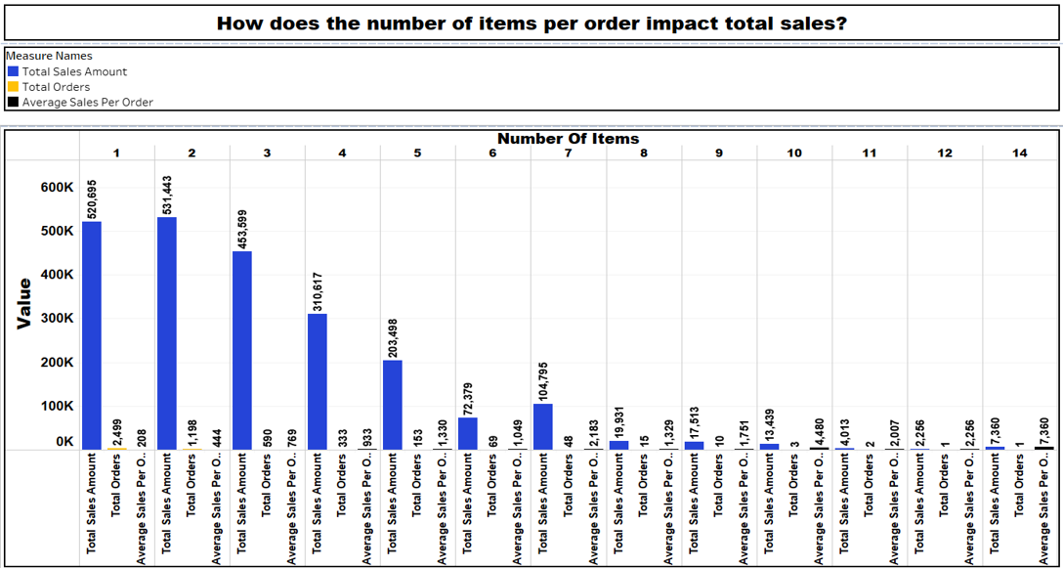

Slide 30
Which *Product Categories* and *Sub-Categories* are frequently purchased together?

Slide 31
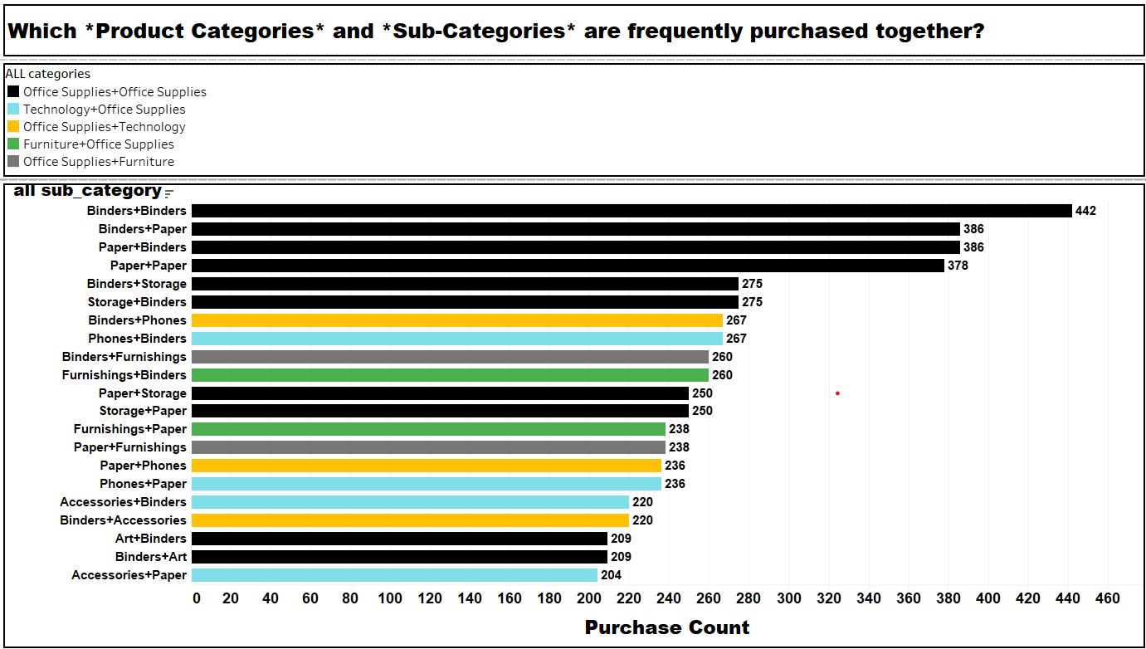

Slide 32
How does the number of new customers (measured by *Customer ID*) compare to sales from returning customers?

Slide 33
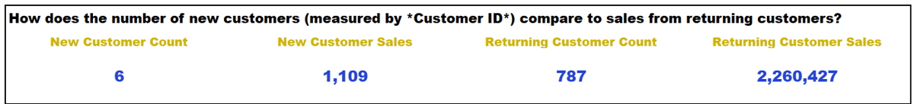

Slide 34
RFM (Recency, Frequency, Monetary) analysis

Slide 35
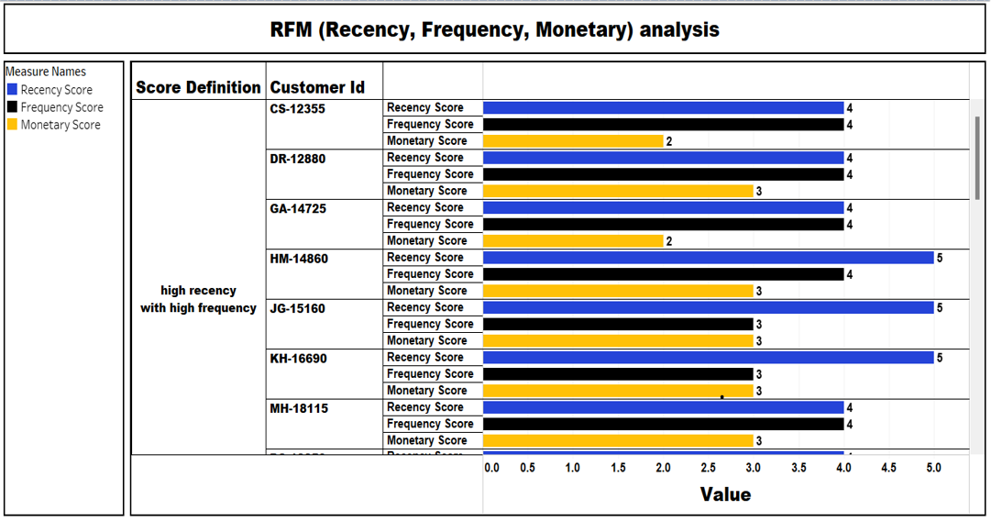

Slide 36
Forecasting using Pandas and Matplotlib

Slide 37
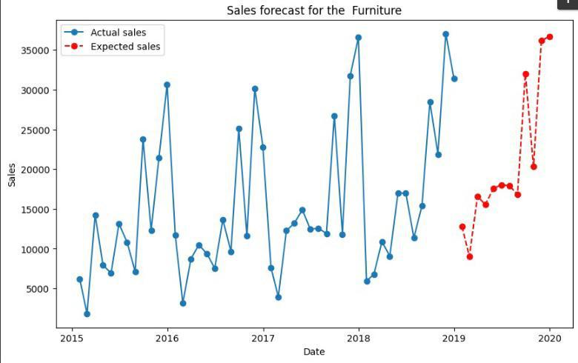

Slide 38
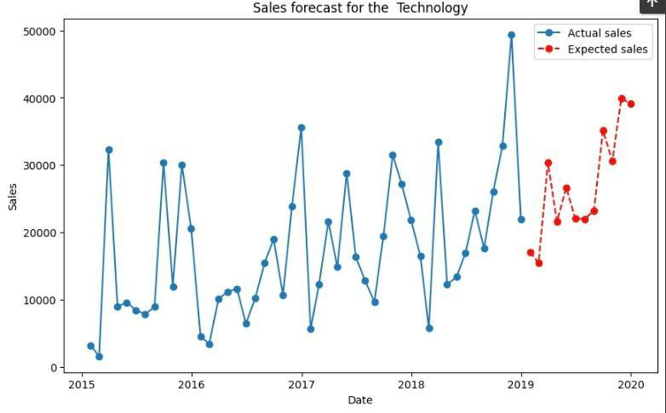

Slide 39
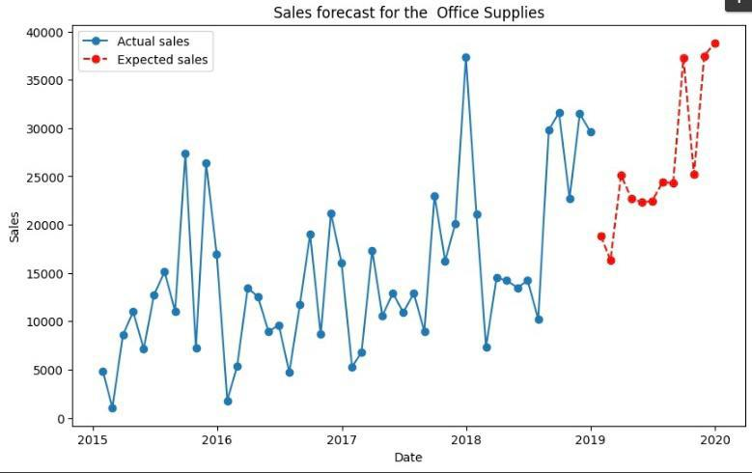

Slide 40

Mahmoud Ramadan
Mostafa Abdelkader
Ahmed saber fahiem saeed
Abdullah Shehata Abd El Hamed

